Slide 1




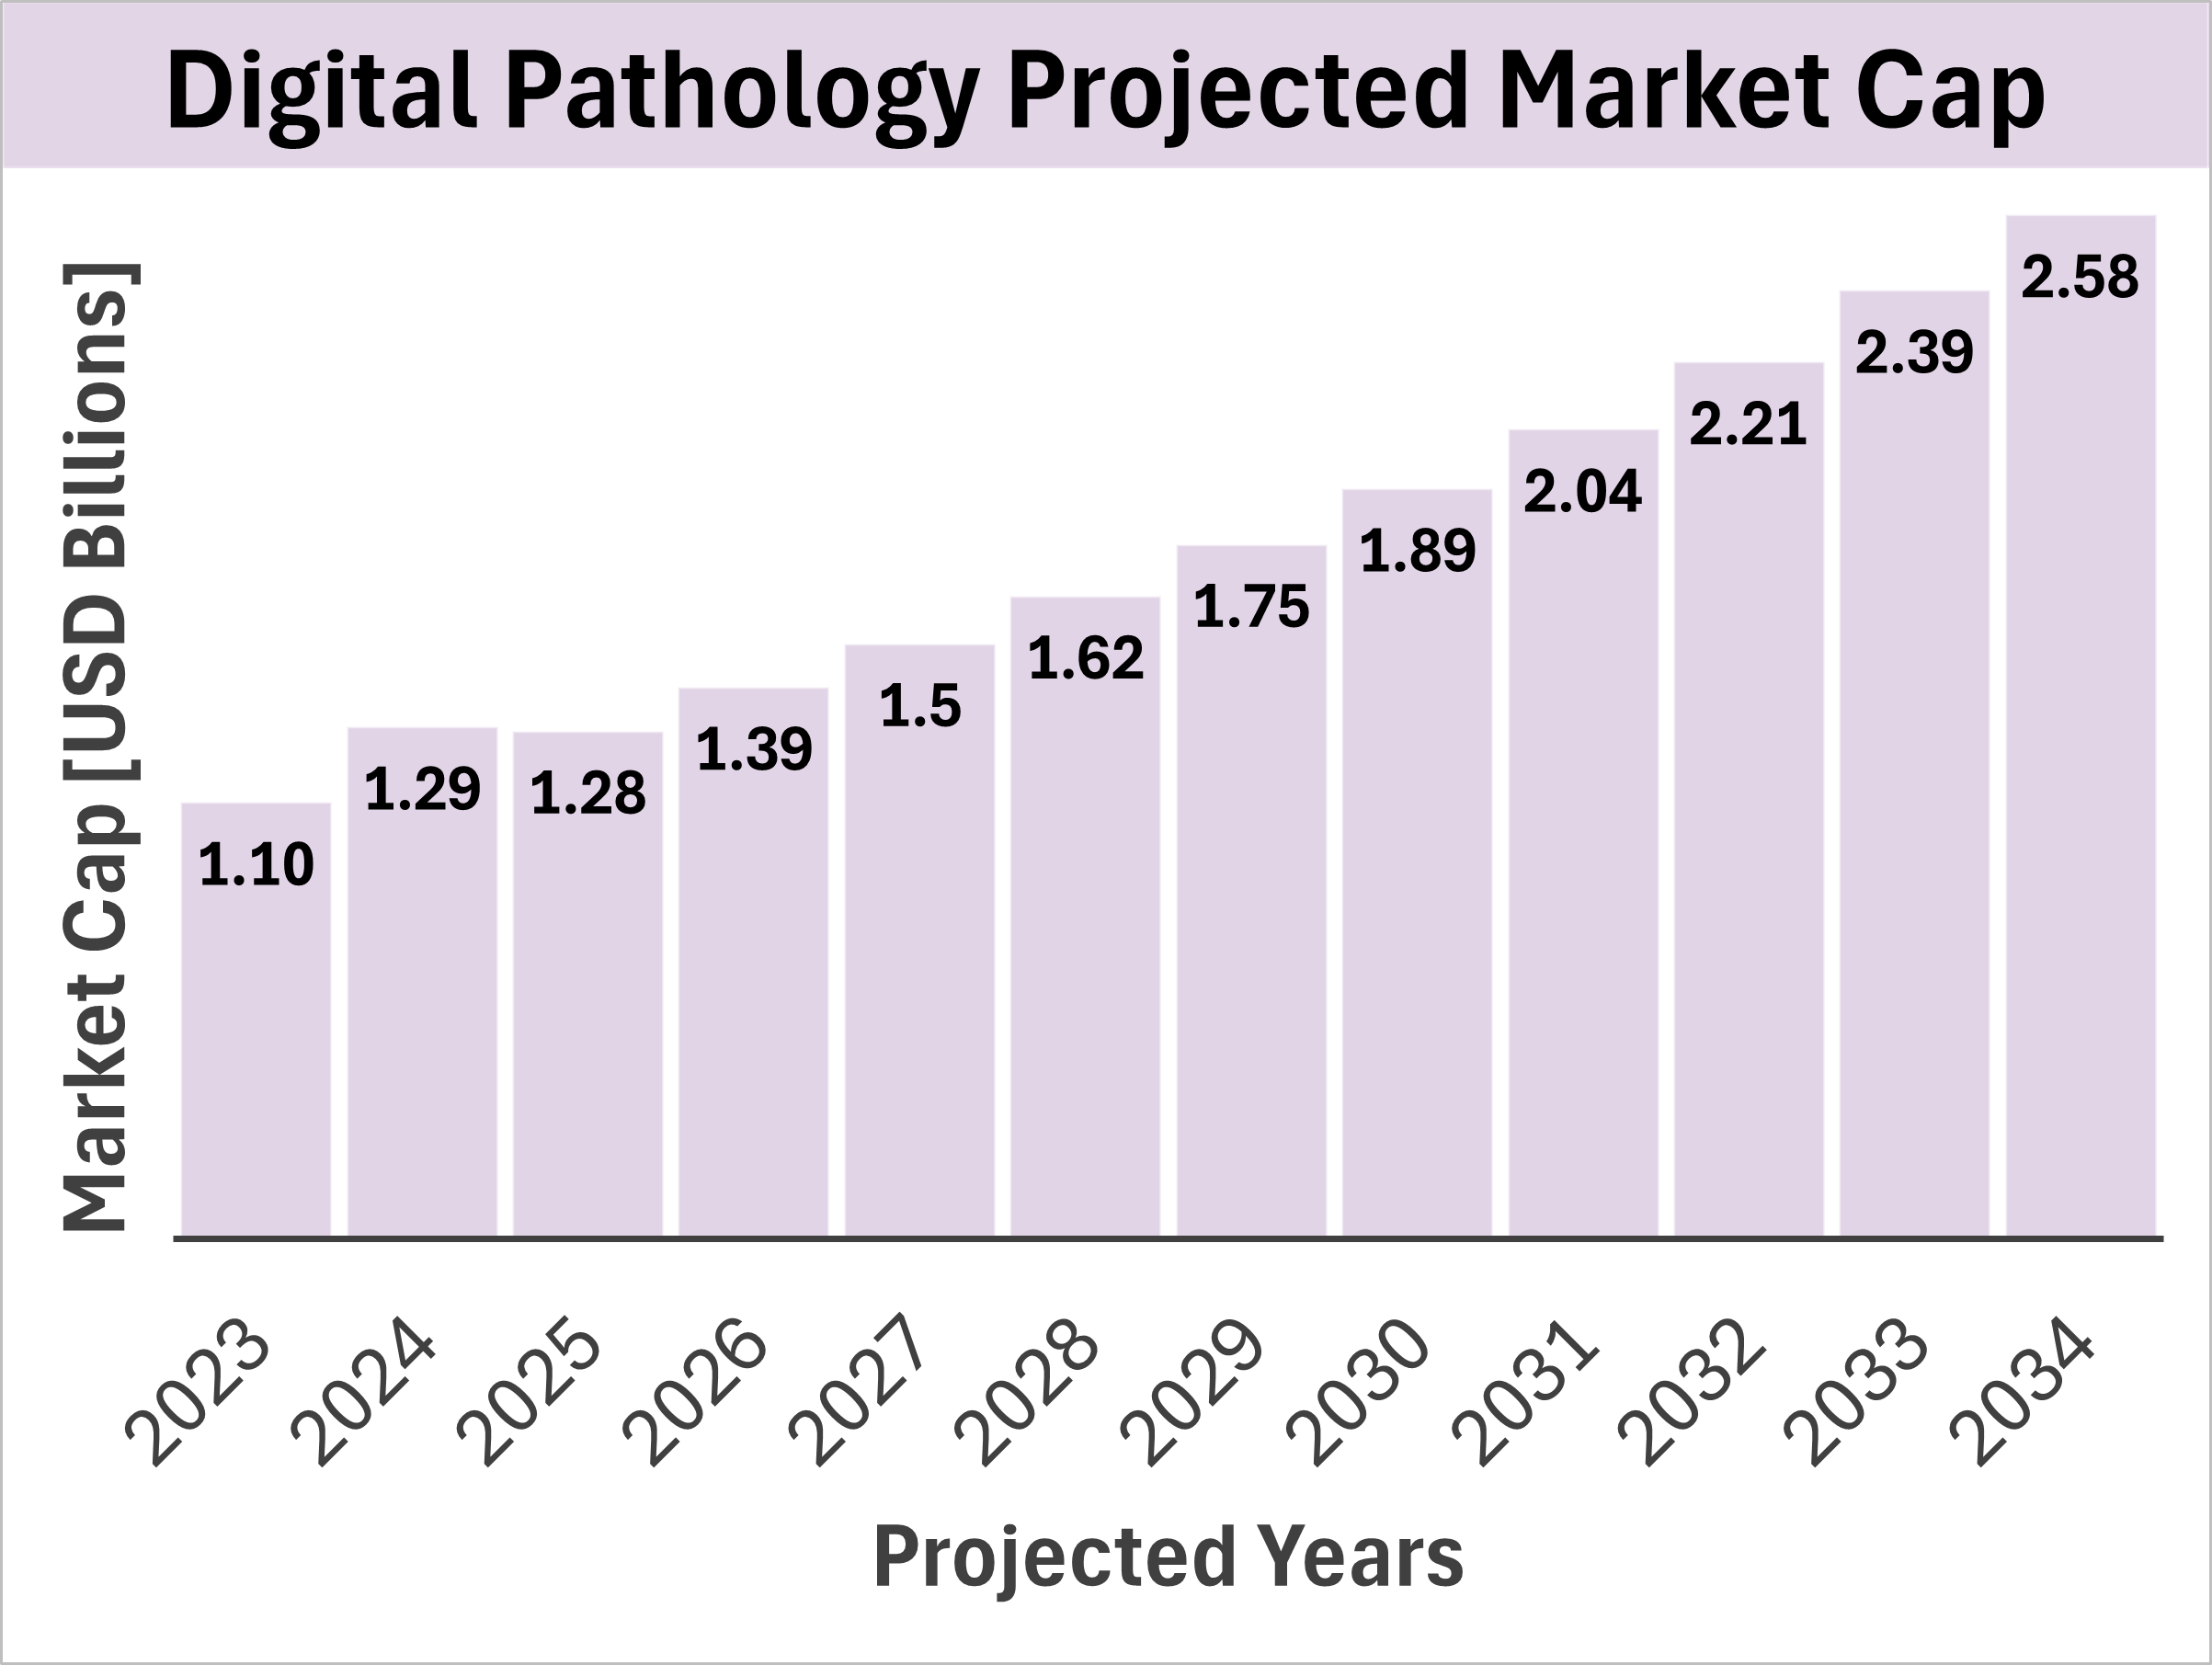
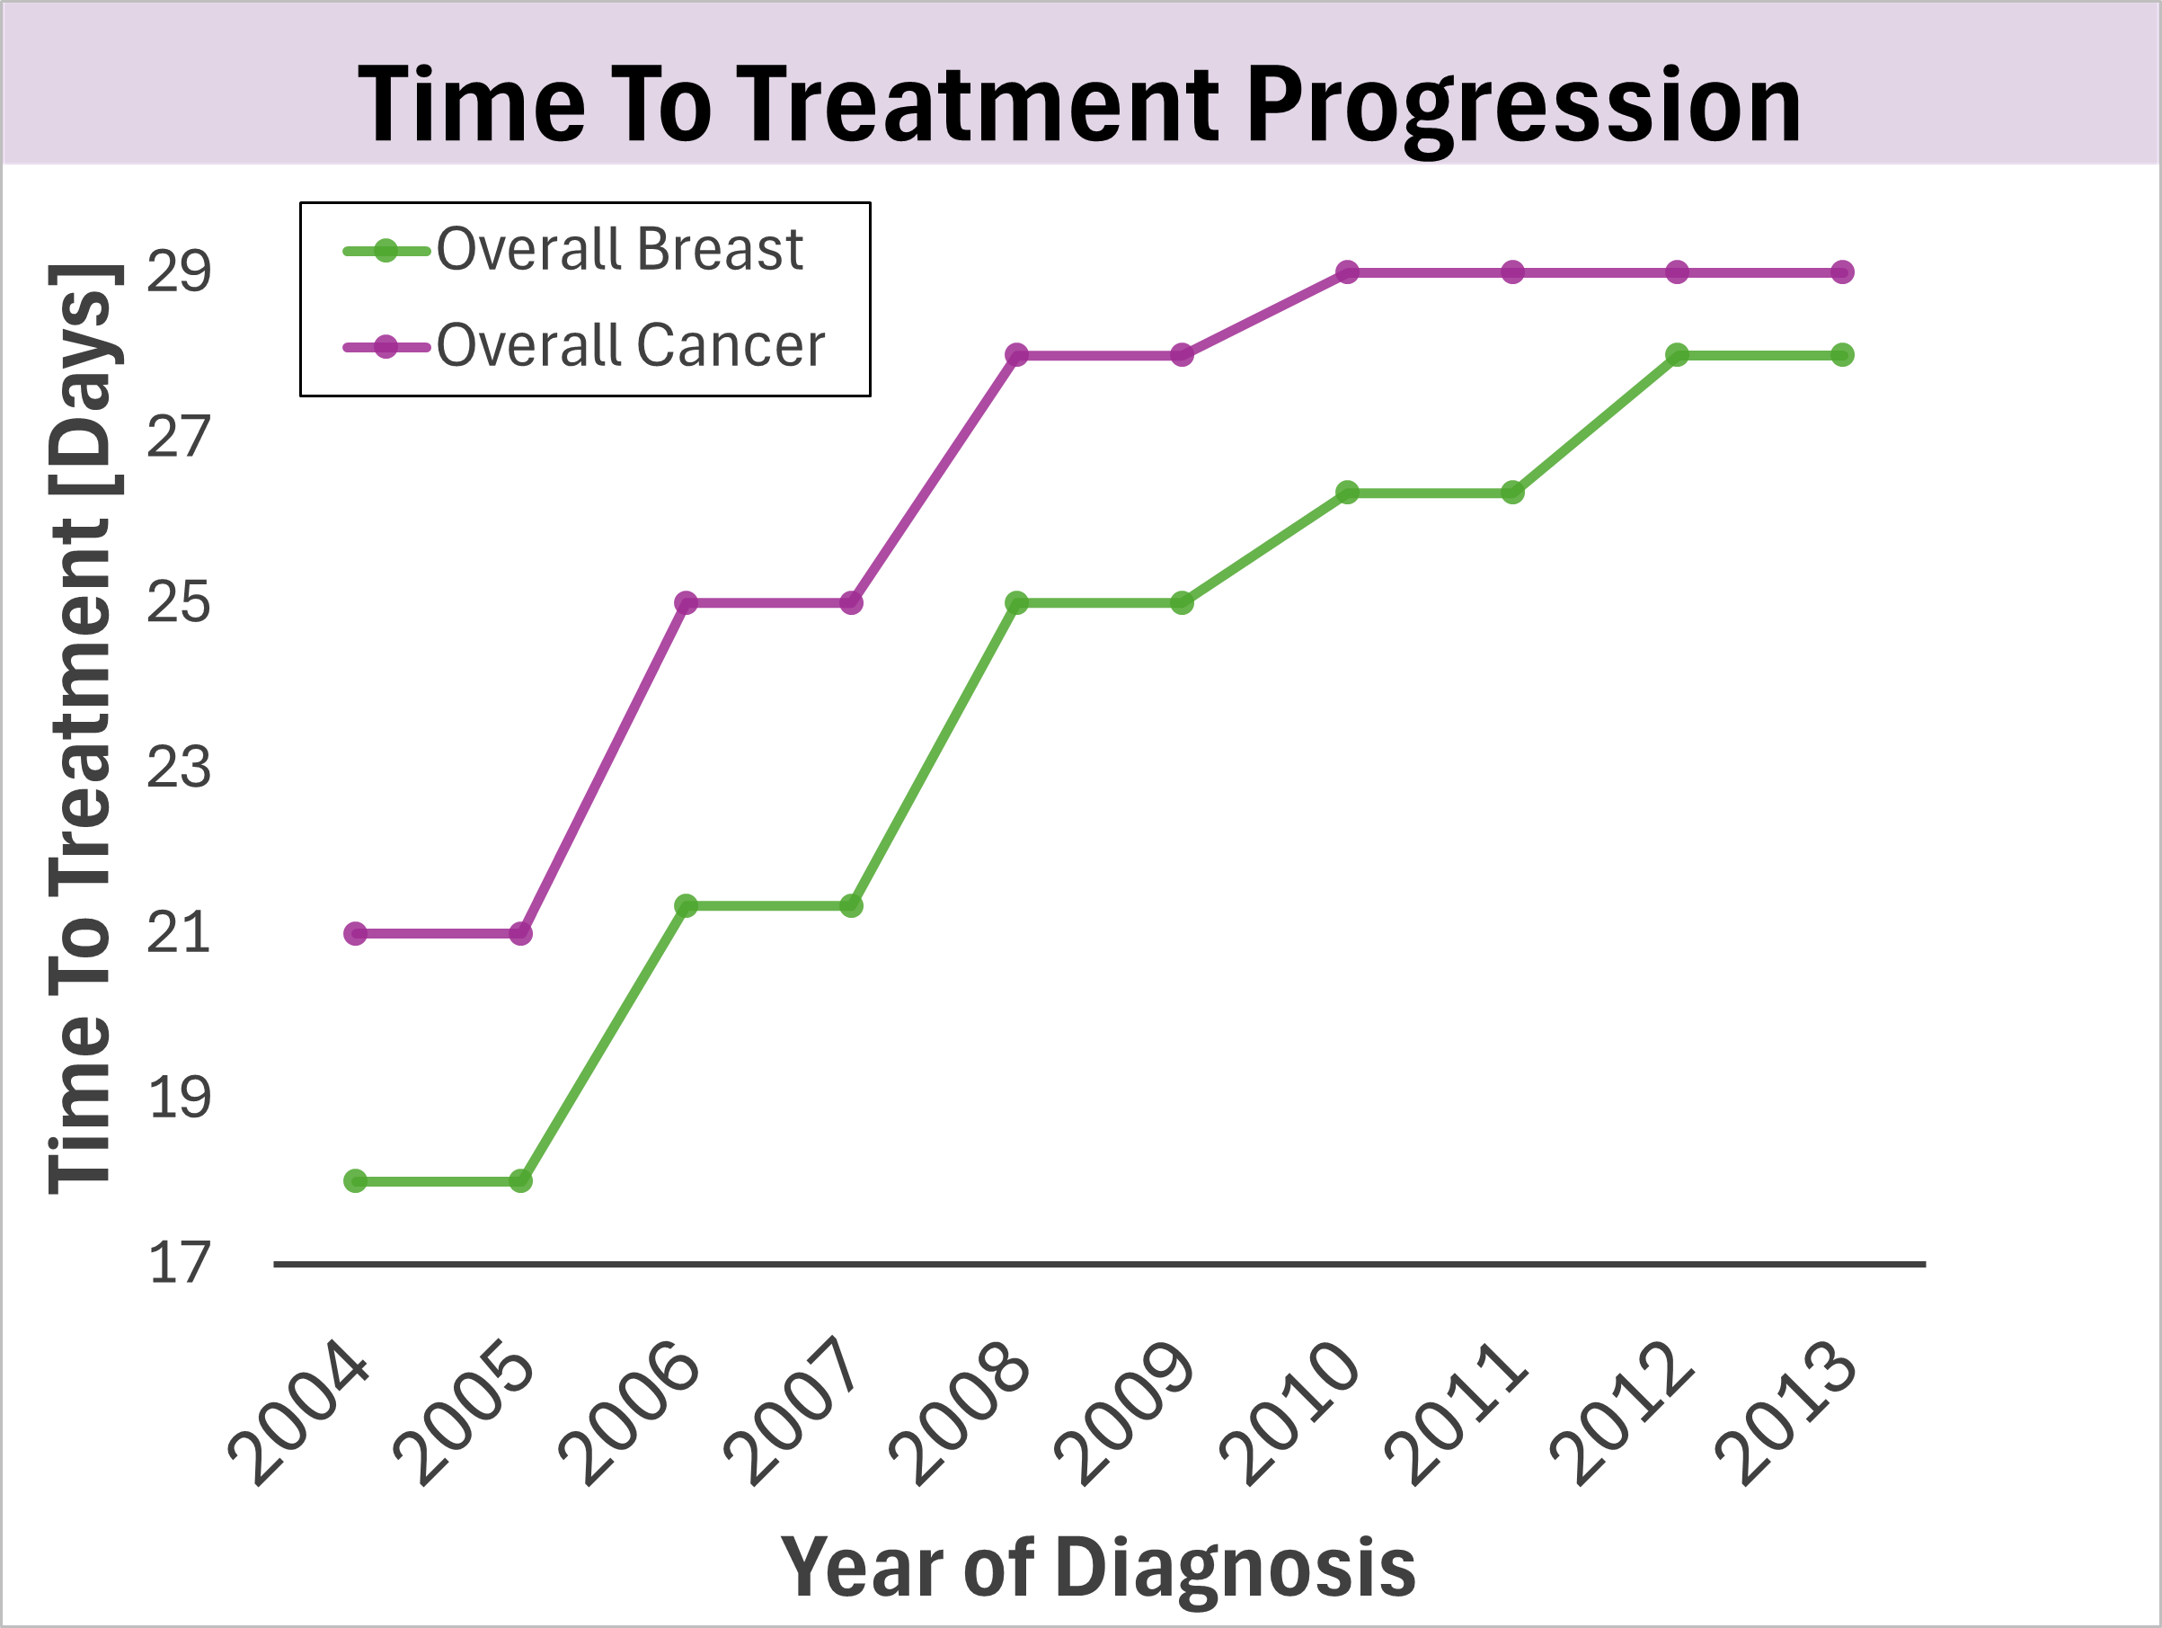
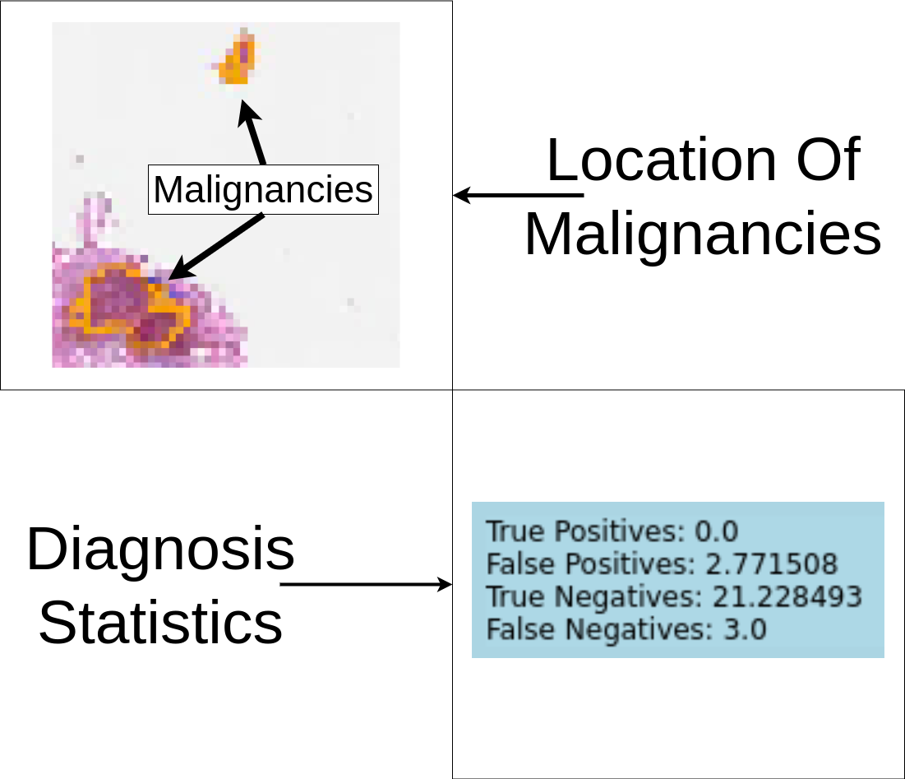
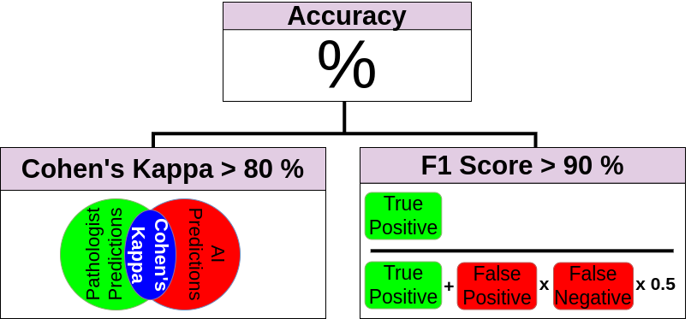
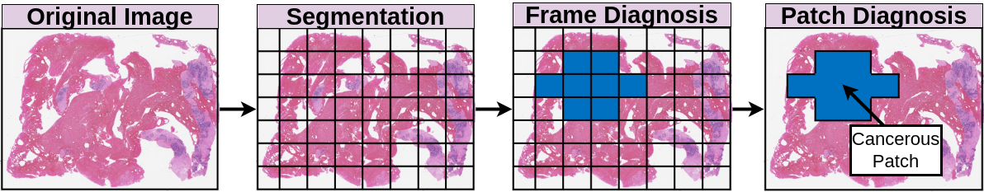

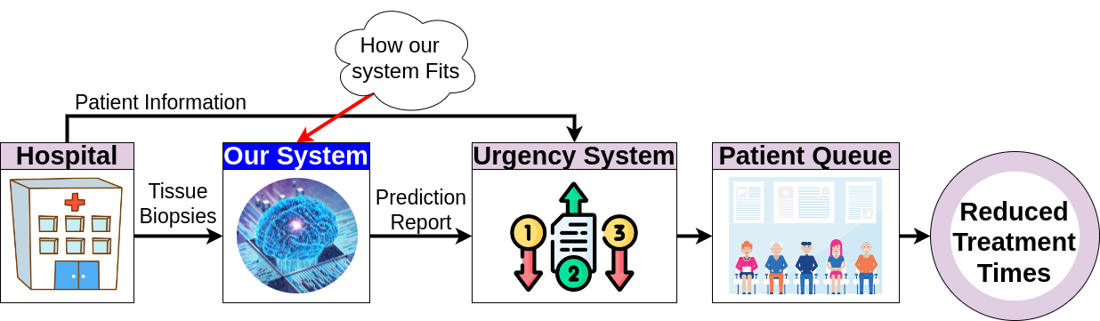


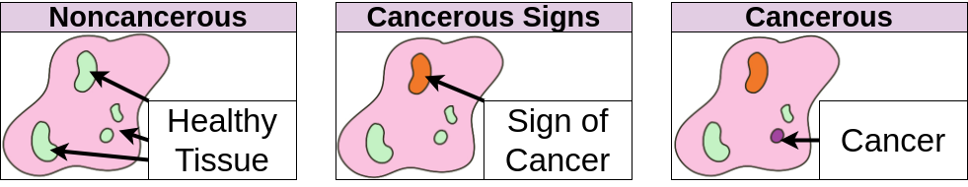
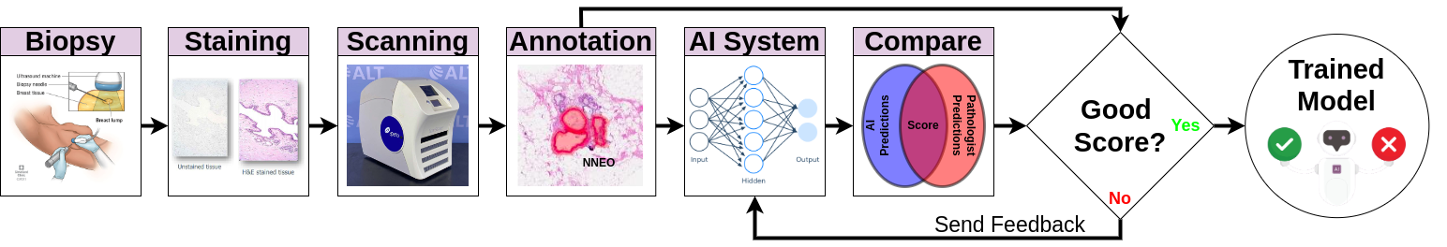

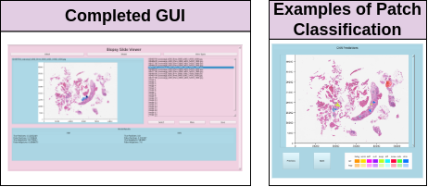

Check out our sources and code!
ISIP
Team 15 Machine Learning Applications in Digital Pathology
Team Members: Leo Berman, Albert Bulik, Yuan Nghiem
Advisor: Dr. Joseph Picone Instructors: Drs. Alibeik & Thomson
Acknowledgements: Claudia Dumitrescu, Phuykong Meng
Problem Statement
Infrastructure Criteria
Performance Criteria
The demand for cancer diagnosis is increasing. As a result, time to treatment is increasing
GUI
[1]
[2]
Patch Level Diagnosis
UN Sustainable
Development Goals
Coding
Language
Whole Slide Diagnosis
Design Method
Testing Method
Infrastructure Results
Performance Results
Future Work/Experiments
Tune model structure and hyperparameters
Data transformations
Longer model training times
Lesson’s Learned
Identify bottlenecks and compensate proactively
Frequently save state to preserve progress in the event of catastrophic failure
F1 Score | Cohen’s Kappa
02.79% | 00.16%
References
[1]
[2]

